Slide 1



Setting up health checks for an ASP.NET Core application and its dependencies
Clyde D’Souza
@ClydeDz

Slide 2

Why?
What?
How?

Slide 3
Why?
You want to be notified about an outage before your customers
Downtime costs money
Transparency builds trust
Notes:
Downtime costs money
Cost of downtime = Minutes down x $ value

Slide 4
What?
What should I monitor?
How frequently do I need to monitor?
Who do I need to notify?
Do I need a public/private status page?

Slide 5
Demo #1
Clyde D’Souza

Slide 6
Demo #2
Clyde D’Souza

Slide 7
Demo #3
Clyde D’Souza

Slide 8

Recap

Slide 9
Demo #4
Clyde D’Souza

Slide 10

The big picture

Slide 11
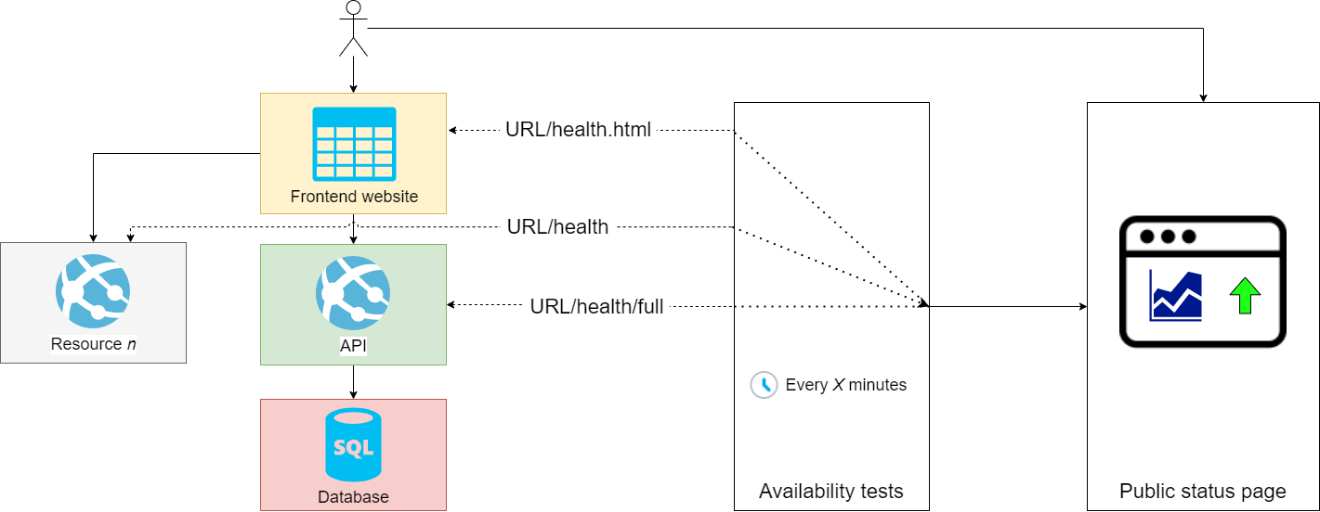

Slide 12

https://github.com/ClydeDz/healthcheck-demo-dotnetconf20
Notes:
Repo is set to private for now. I’ll be updating this setting to public a day before the presentation.

Slide 13

Thanks for joining!
@ClydeDz

